Slide 1



ecx.io Frontend Bootcamp — Introduction to CSS 28.06.2021.

Slide 2



Introduction round

Slide 3
Agenda
Selector Specificity
Units in CSS
Variables in CSS

Slide 4
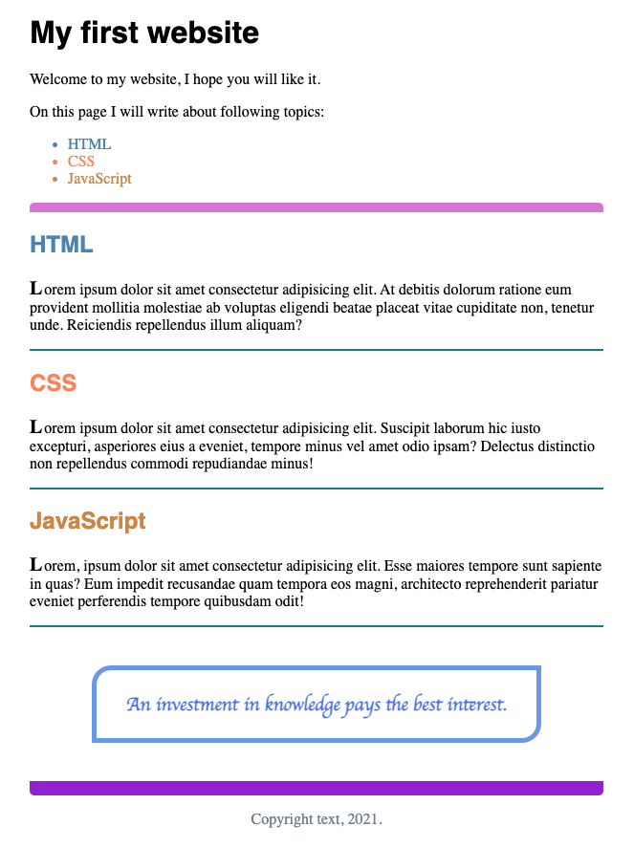

Notes:
Let’s play with what we learned so far and create following markup and styles.
Demonstrate how the image can be imported to Chrome for example and how to extract colors…
Let them do it first alone, give them 30 minutes.
Stash reference: 01-selectors-recap.html

Slide 5
Selector Specificity

Slide 6
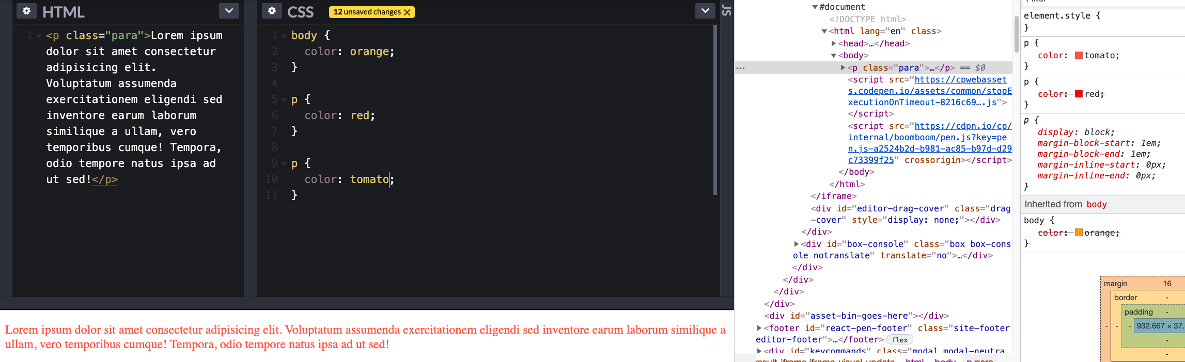
Selector Specificity
Notes:
Explain how CSS works, what is applied by default nature of it.

Slide 7
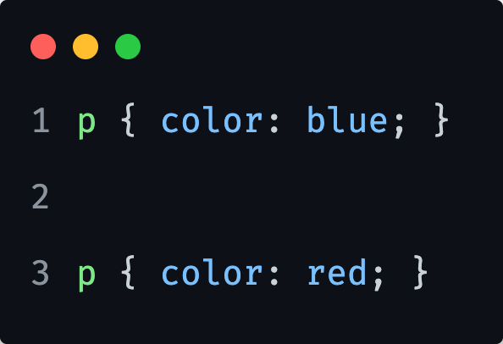
Which CSS styles do you think will be applied?

Slide 8
Which CSS styles do you think will be applied?
On line 3.

Slide 9
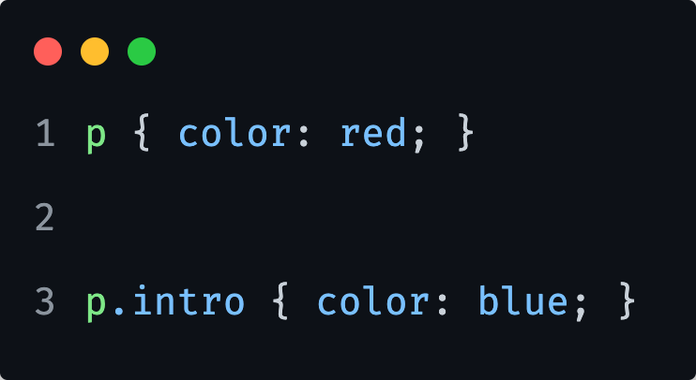
And now?

Slide 10
And now?
On line 3.

Slide 11
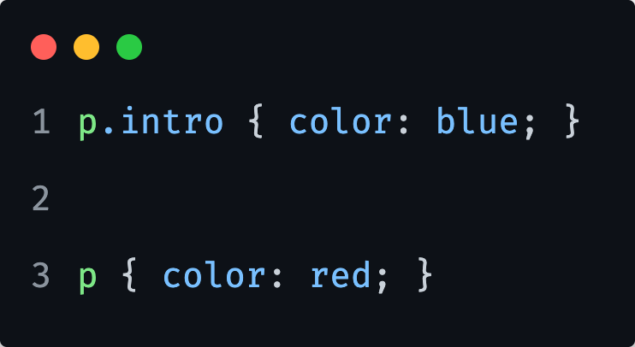
And now?

Slide 12
And now?
On line 1.

Slide 13
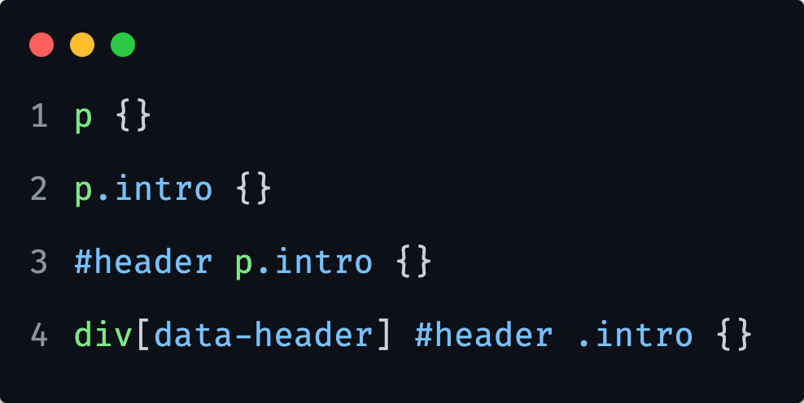
Selector Specificity
The origin and sorting order of CSS helps browsers to determine which rules win out over others.
When one of those methods completely fails, there is a conflict as to which CSS rule should be applied.
CSS has in place a way to deal with those conflicts: the specificity of the CSS selector.
Notes:
The higher the specificity of a CSS selector, the greater the likelihood its declarations are used over another CSS rule's declarations.

Slide 14
Selector Specificity: table
Selector | Specificity | Description
* | 0-0-0 | wild card/universal selector, selects everything
h1 | 0-0-1 | element selector
.title | 0-1-0 | class selector
[data-title] | 0-1-0 | attribute selector
:active | 0-1-0 | pseudo-class selector
#title | 1-0-0 | ID selector
style=“” | 1-0-0-0 | inline styles
!important | 1-0-0-0-0 | overrides everything except other !important set directly on element (inline)

Slide 15
Selector Specificity: combination samples
Selector | Specificity
div | 0-0-1
.class | 0-1-0
:first-child | 0-1-0
div#withid.andclass | 1-1-1
div#withid | 1-0-1
div.withclass | 0-1-1
.class-one:not(.class-two) | 0-2-0
div:empty | 0-1-1

Slide 16
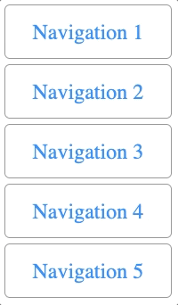
1) Recreate a following navigation list:
Notes:
Important to consider for this navigation list:
What elements are used
What classes/id’s etc are used
General approach to markup and style
Let them do it first alone, give them 15 minutes.
Stash reference: 02-selectors-specificity.html

Slide 17
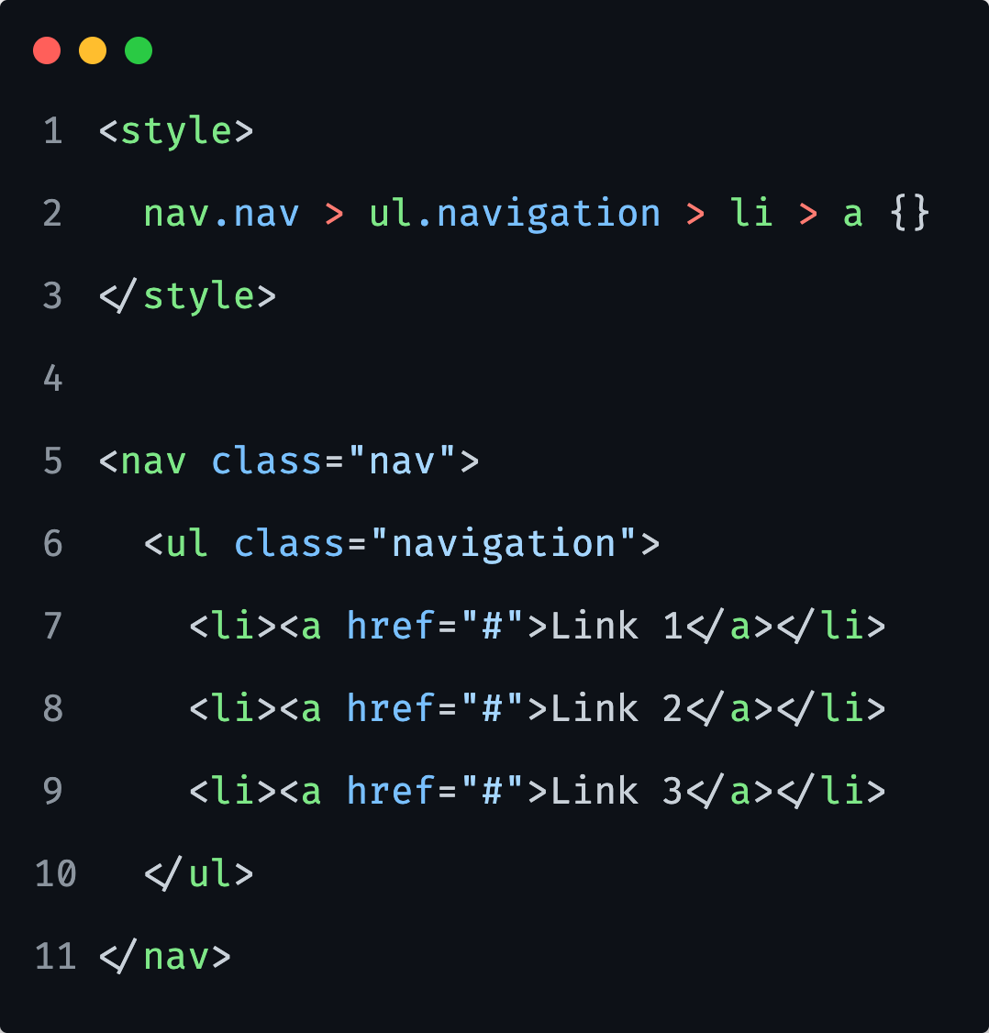
Selector Specificity
Avoid over-specific selectors.
One of the most common problems we can see among various Front-end developers.
This kind of selectors can be overly specific and becomes hard to maintain over time.
If we would write more code like this, we would end up with a lot of !important keywords in our project.
Notes:
Just by adding a class to anchor in this case/sample, would work just fine. As long as its only specific to nav.
It is not just about selector combinations, but also about selector naming convention.
Specificity of above selector is equal to: 0-2-4
With only 1 or 2 classes, it can be as easitly 0-1-0 or 0-2-0.. In terms of strength, it will be almost the same, but still less
Some other issues:
#nav ul {}
#nav ul li a {}

Slide 18
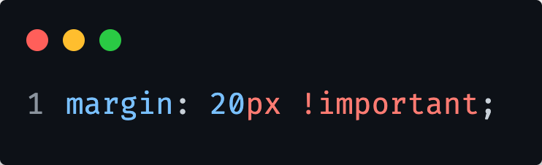
Selector Specificity
Avoid !important
If you are using the !important keyword that means you have one something wrong.
Usually it is about overly-specific selector.
Notes:
Show what kind of implications we might get of general class names and inheritance.
Ie, generic/global class names like :list, item, media, image, etc…

Slide 19
Units in CSS

Slide 20
CSS Units
CSS has several different units for expressing a length.
Length is a number followed by a length unit, such as 10px, 2em, etc.
For some CSS properties, negative lengths are allowed.
Notes:
Many CSS properties take "length" values, such as width, margin, padding, font-size, etc.
A whitespace cannot appear between the number and the unit. However, if the value is 0, the unit can be omitted.

Slide 21
Units in CSS
Types of length units
Absolute lengths
Are fixed and a length expressed in any of these will appear as exactly that size.
Are the same size regardless of the parent element or window size.
Relative lengths
Relative length units specify a length relative to another length property.
Notes:
Absolute length units are not recommended for use on screen, because screen sizes vary so much. However, they can be used if the output medium is known, such as for print layout.
Absolute units can be useful when working on a project where responsiveness is not being considered.
Relative length units scale better between different rendering medium.
Relative units are useful for styling responsive sites because they scale relative to the parent or window size.

Slide 22
Units in CSS
Absolute lengths
Pixels (px) are typically the most popular absolute unit for screens.
Centimeters, millimeters, and inches are more common for print.
Unit | Description
cm | centimeters
mm | milimeters
in | inches | 1in = 96px = 2.54cm
px | pixels | 1px = 1/96th of 1in
pt | points | 1pt = 1/72 of 1in
pc | picas | 1pc = 12pt

Slide 23
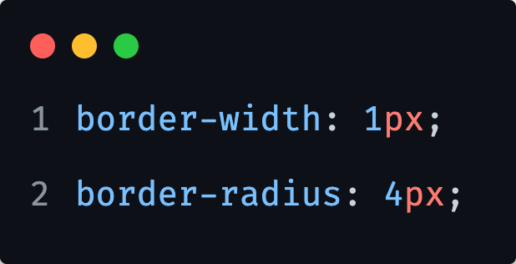
Units in CSS
Pixels
Some properties where we might use pixels:
border-width
border-radius
Note: You can use pixels wherever you want. This is just my suggestion and approach when it comes to working with pixel values.
Notes:
Pixels can be set and stored in variables to have different base font size for mobile and desktop for example, in case we want to ensure actual pixel’s being used for different screen breakpoints.
When using with calc() it can be useful to get some values calculated out of some pixel value.
Pixels can also be used to define a base ground for other relative units.

Slide 24
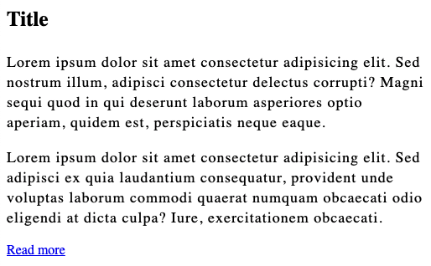
1) Create a markup and style it as you wish, as long as you use following properties and PX’s as units: width, height, font-size, line-height, letter-spacing, margin and padding.
Notes:
Let them do it first alone, give them 5 minutes.
Stash reference: 01-units-pixels.html

Slide 25
Units in CSS * Viewport = the browser window size. If the viewport is 50cm wide, 1vw = 0.5cm.
Relative lengths
Relative units are mainly used for creating responsive layouts.
Relative units can be a little more difficult than absolute units in determining which to use.
Most common are em, rem, vw, vh and %.
Unit | Description
em | Relative to the font-size of the element
ex | Relative to the x-height of the current font
ch | Relative to the width of the "0" (zero)
rem | Relative to font-size of the root element
vw | Relative to 1% of the width of the viewport*
vh | Relative to 1% of the height of the viewport*
vmin | Relative to 1% of viewport's* smaller dimension
vmax | Relative to 1% of viewport's* larger dimension
% | Relative to the size of the container
Notes:
As a general rule, relative units can be used as the default for responsive sites. This can help you avoid having to update styles for different screen sizes.
It’s not always clear which of these options is best to use for each type of CSS property.
For example, % is usually more appropriate for layout-related properties like width than it would be for font-size.

Slide 26
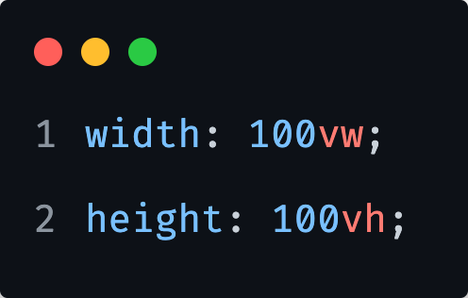
Units in CSS
VW & VH
The vw and vh are not in relation with size of its parent.
Full-screen sections are probably the most widely-known use cases of viewport units.
Notes:
Useful sometimes, as they are always relative to the viewport. No cascading or influence by parent elements.
Percentage units inherit the size of their parent element while viewport units don’t. Viewport units are always calculated as the percentage of the viewport size. As a result, an element defined by viewport units can exceed the size of its parent.
Stash reference: 03-units-vw.html
One such live example:
https://overwatch2.playoverwatch.com/en-us/trailer

Slide 27
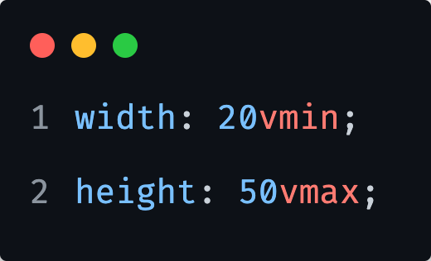
Units in CSS
VMIN & VMAX
Allow us to access the size of the smaller or the larger side of the viewport, according to the following rules:
100vmin = 100vw or 100vh whichever is smaller
1vmin = 1vw or 1vh whichever is smaller
100vmax = 100vw or 100vh whichever is larger
1vmax = 1vw or 1vh whichever is larger
Notes:
Stash reference: 02-units-vmin.html
Example of vmin in use as with title, to be always readable:
https://codepen.io/dudleystorey/pen/ALWrXZ

Slide 28
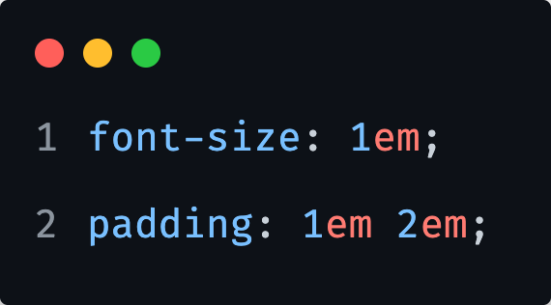
Units in CSS
EM
Some properties where we might use em:
font-size
padding
line-height
Relative to the current font-size of the element, or by inheritance from the parent.

Slide 29
1) Redo a previous exercise but this time with EM’s.
Play with some of the measures in browser to see how it affects the box you created.
Notes:
Let them do it first alone, give them 5 minutes.

Slide 30
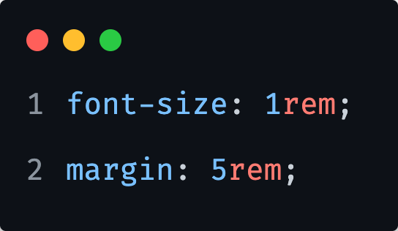
Units in CSS
REM
Some properties where we might use rem:
font-size
margin
Relative to the font-size of the root.
(e.g., <html> element)

Slide 31
1) Redo a previous exercise but this time with REM’s.
Play with some of the measures in browser to see how it affects the box you created.
Notes:
Let them do it first alone, give them 5 minutes.

Slide 32
Units in CSS
EM or REM ?
It’s highly debatable.
Some developers avoid rem entirely, claiming that using rem makes their components less modular.
Others use rem for everything, preferring the simplicity that rem provides.
EM unit can be problematic. If the font size was not defined on an element, we need to trace it up the hierarchy to figure out what font size will be inherited.

Slide 33
1) Redo a previous exercise but this time with try to combine EM and REM’s.
Play with some of the measures in browser to see how it affects the box you created.
Notes:
Let them do it first alone, give them 5 minutes.

Slide 34
Let’s look at last example together…

Slide 35
1) Create 3 sections. In each section add 2 paragraphs.
2) Make each section take full height of the viewport.
3) Add different font size to each section. Define it in REM’s.
4) Make each paragraph in section inherit the font size and define basic styles: line height, margin, font-size, based on its font size.
When you change the root font size, all content should adapt to it.
Notes:
Let them do it first alone, give them 10 minutes.

Slide 36
CSS Variables

Slide 37
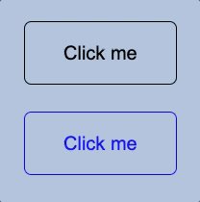
Create following markup and styles:
- 2x buttons with same content
- different colors and hover states
Notes:
Before we start with Variables, lets create a small example, that we will later reuse with variables.
Let them do it first alone, give them 10 minutes.
Stash reference: 01-button-theming-before-variables.html

Slide 38
CSS Variables
currentColor
First CSS variable.
Introduced with SVG’s.
Supported everywhere.
Notes:
It always results to the value of color.
Show an example as:
<div class="block">CSS</div>
div.block {
padding: 20px;
margin: auto;
display: inline-block;
background: radial-gradient(transparent 85%, currentColor 0);
color: blue;
}

Slide 39
CSS Variables
Are expansion of this ‘currentColor’ concept (in a way).
They are custom properties that start with the double dash.

Slide 40
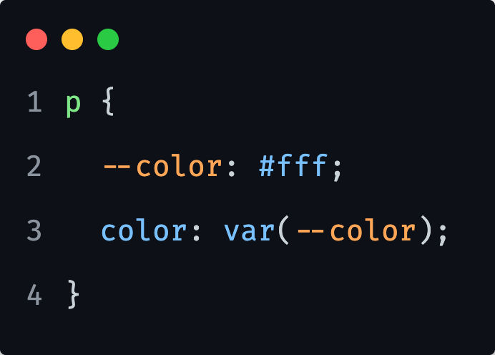
CSS Variables
We define a variable with double dash as:
--color: #fff;
Then we can refer to them like this:
color: var(--color);
Notes:
Why the variables are defined with double dash instead of hash or dollar sign for example?
Two reasons:
so people can use both CSS and LESS/SASS variables (there are things CSS variables can do, that LESS/SASS variables can not)
It is compatible with existing CSS parsers and CSS properties can only contain letters and dashes, it also very unlikely that we will have some other properties with double dash in future (where it might clash) (apparently it came out of prefix property, with an empty prefix: `-webkit-property` then you remove the webkit and you get double dash

Slide 41
CSS Variables
In our example on the left, we can as easily use currentColor as well, so what is the catch?

Slide 42
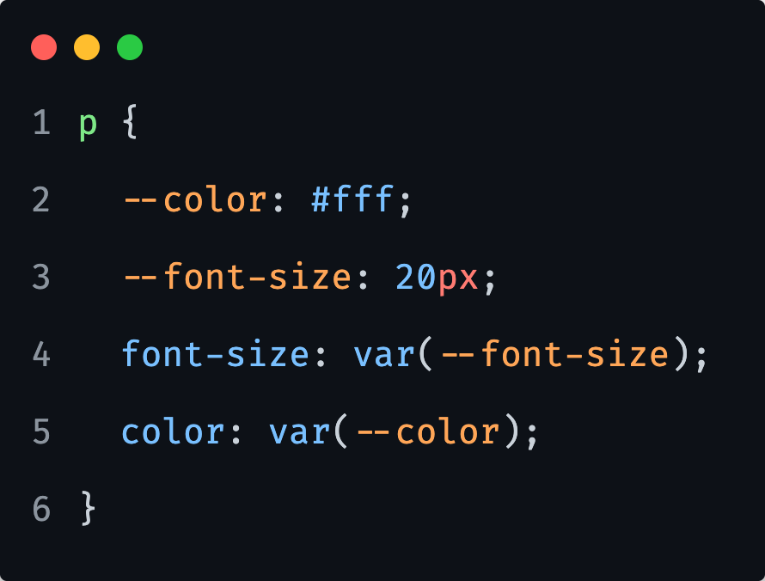
CSS Variables
If we extend our example with another property and variable, we can see the difference already.
We can not achieve this with currentColor.

Slide 43
1) Create a style for <body> tag and add a paragraph of text.
2) Change color and background color with variables.
Notes:
Let them do it first alone, give them 5m.

Slide 44
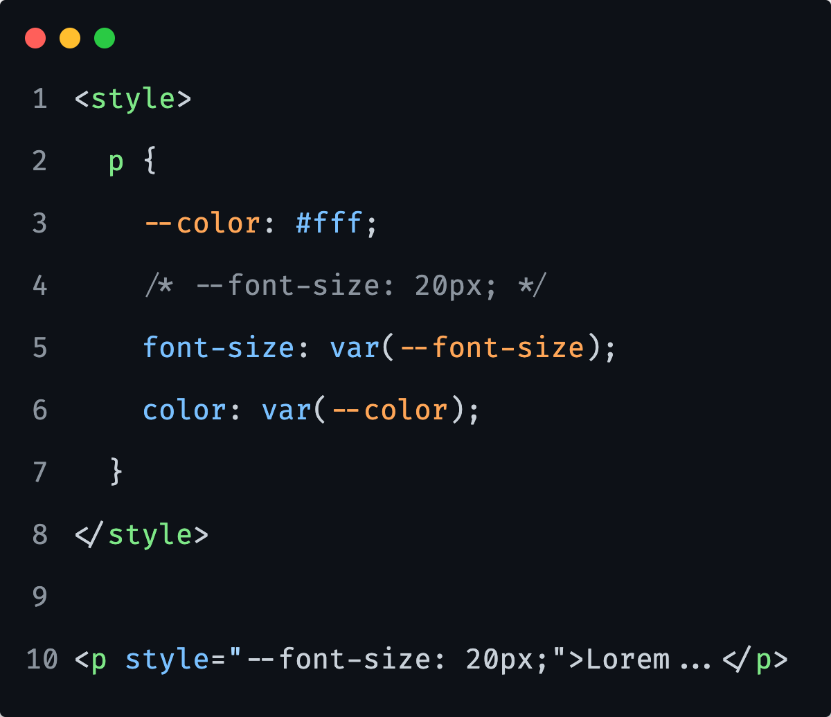
CSS Variables
The CSS custom properties (variables), can also be set anywhere…
In an internal styles or external style sheet.
But also, inline… what can become very powerful.
Notes:
And on inline styles, we can change it dynamically with JavaScript.
And this is the key difference and most important part of it, they are live, they can be updated at any point, either by pseudo-class, or javascript, inline styles, anything.

Slide 45
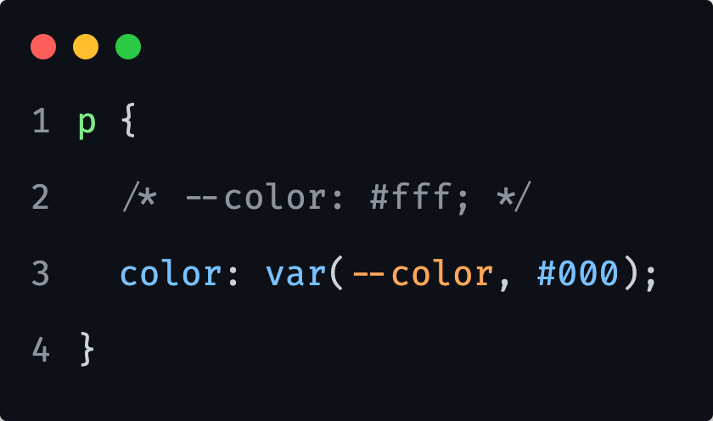
CSS Variables
Fallback value.
Notes:
We set a 2nd parameter as a fallback to where we are calling a css variable. So in case a variable is not set or does not exist, it will just take a fallback value.
Fallback value will be considered only if the browser understands CSS variables.
So, if we would to have another color property set with a color, it would be applied on browsers that do not support css variables.
e.g.
color: red;
color: var(--blue, cyan)
KEEP IN MIND:
If we provide an invalid value to a property, at the computed-value time it will result to ‘initial’
Meaning that background will be transparent, color will be black etc… each property has its initial value

Slide 46
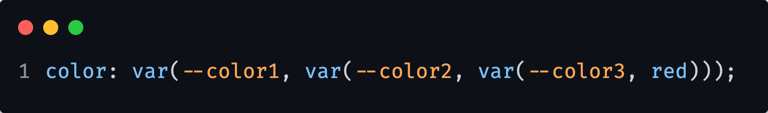
CSS Variables
Fallback value(s) can be chained.

Slide 47
Optimize our previous exercise with CSS Variables.
Notes:
Let them do it first alone, give them 10 minutes.
Stash reference: 02-button-theming-after-variables.html
We can also set direct color via inline styles and ditch the button variant class completely.
This way, we encapsulate the implmentation.

Slide 48
CSS Variables
Work like normal CSS properties.
Therefore, they are called CSS Custom Properties, and not CSS Variables.
Notes:
Key takeaway from previous slides…

Slide 49
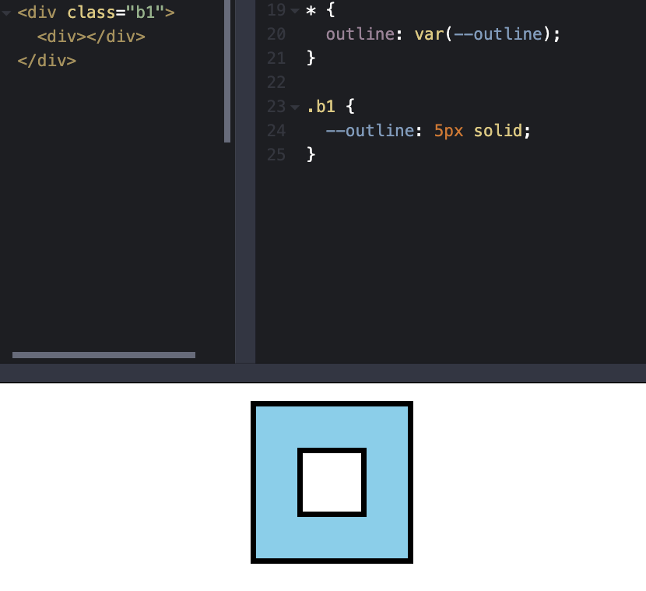
CSS Variables
We define styles on a parent and child also gets it?
This is happening because CSS Variables are inherited properties.
Notes:
Everywhere, where the outline variable is set, set the outline property to that.
We can notice that inner div has also the same style as parent div, even though we only set it to the parent div.
This is because css variables are inherited properties.
Which can be quite useful. For example, we can set them on HTML element and access them on any element.
The outline property
WE did not cover it so far, so here is an explanation;
An outline is a line that is drawn around elements, outside the borders, to make the element "stand out".
Outlines differ from borders! Unlike border, the outline is drawn outside the element's border, and may overlap other content. Also, the outline is NOT a part of the element's dimensions; the element's total width and height is not affected by the width of the outline.
Rest is pretty much similar like border, its also a shorthand for width, style and color.

Slide 50
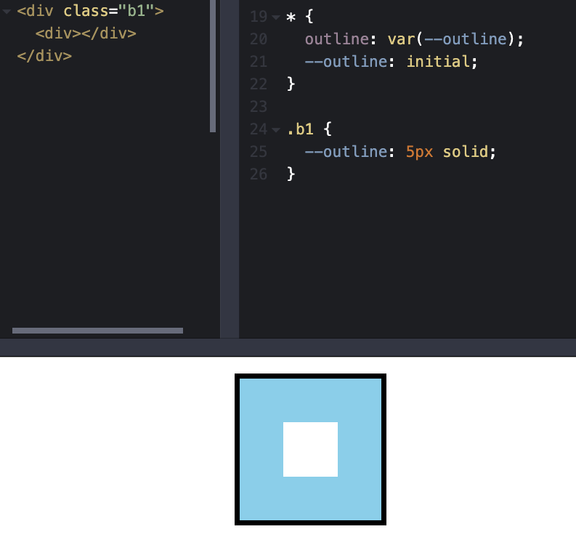
CSS Variables
You might not want this behavior.
In that case we use the same universal selector and set them to initial.
Notes:
And because inheritance always has lower precedence than explicitly referencing the element (even with the zero specificity of the star selector), if you haven't set the outline variable explicitly on the element, then it will just be initial which means no value, the declaration will not be applied.

Slide 51
CSS Variables
You might not want this behavior.
In that case we use the same universal selector and set them to initial.
Even though they are inherited properties, we can change that.

Slide 52
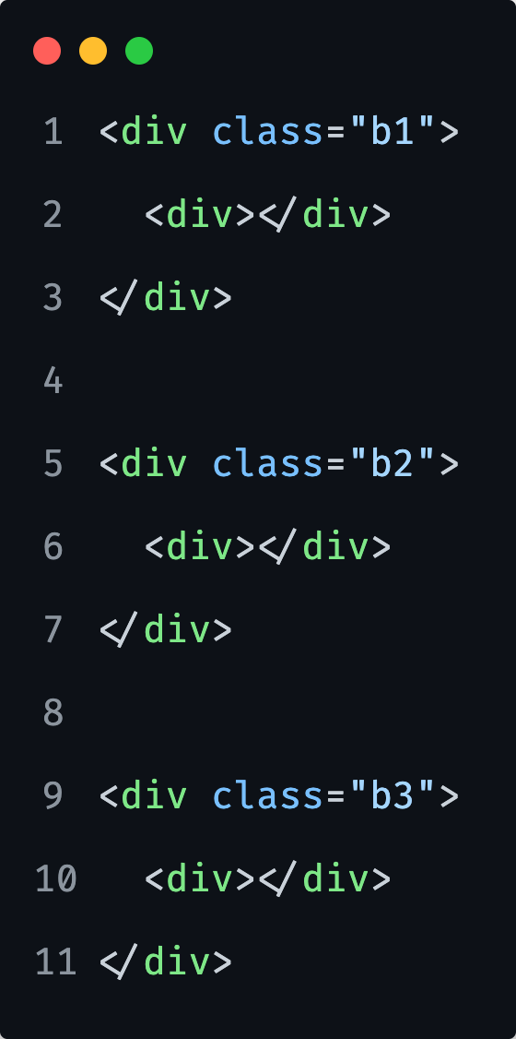

1) Create given structure, style it similarly to right image.
2) Note the black line at bottom of each big box, create it by providing a CSS variable. You should not set a border property on a <div>.
Notes:
Let them do it first alone, give them 5 minutes.
Stash reference: 03-border-with-variable.html

Slide 53
CSS Variables
Some things to keep in mind…
--foo:; is invalid
--foo: ; is valid
--foo =/= --FOO (case sensitive)
--color: var(--color); initial

Slide 54
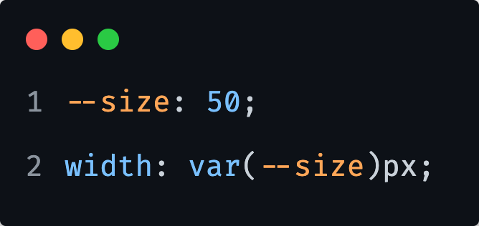
CSS Variables
Browser does not see a string, instead it will see a number.
In the end it will set it as 50 px,
instead of 50px.
Notes:
CSS Variables values are basically token lists.

Slide 55
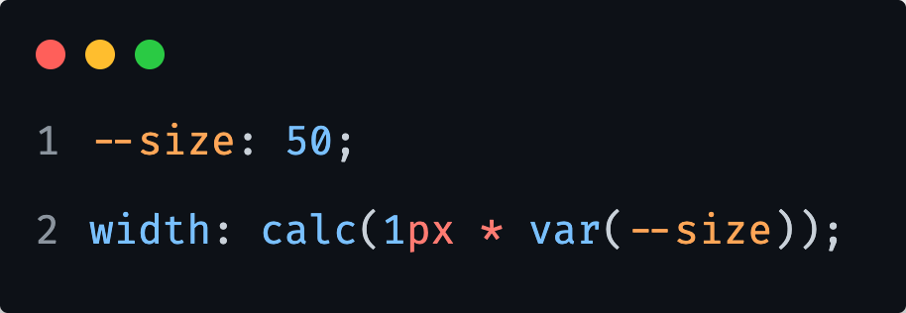
CSS Variables
We can do a slight hack with calc to get what we want.

Slide 56
CSS Variables
We should primarily use variables for data and not CSS values.
Notes:
We can do anything to pure data, if its just numbers we can always convert them to anything we want.
If its CSS value, like 10px, you cant do very much with it (in terms of using it in calc etc)

Slide 57
CSS Variables
Enable theming independent of CSS structure.
Notes:
Keep in mind that we can also have internal/local varibles that then developer an take advantage off, from outside of the component.
Example:
<button style="--color: cyan">Click me</button>
button {
--col: var(--color, black);
border: 3px solid var(--col);
background: transparent;
color: var(--col);
}
button:hover {
background: var(--col);
color: white;
}

Slide 58
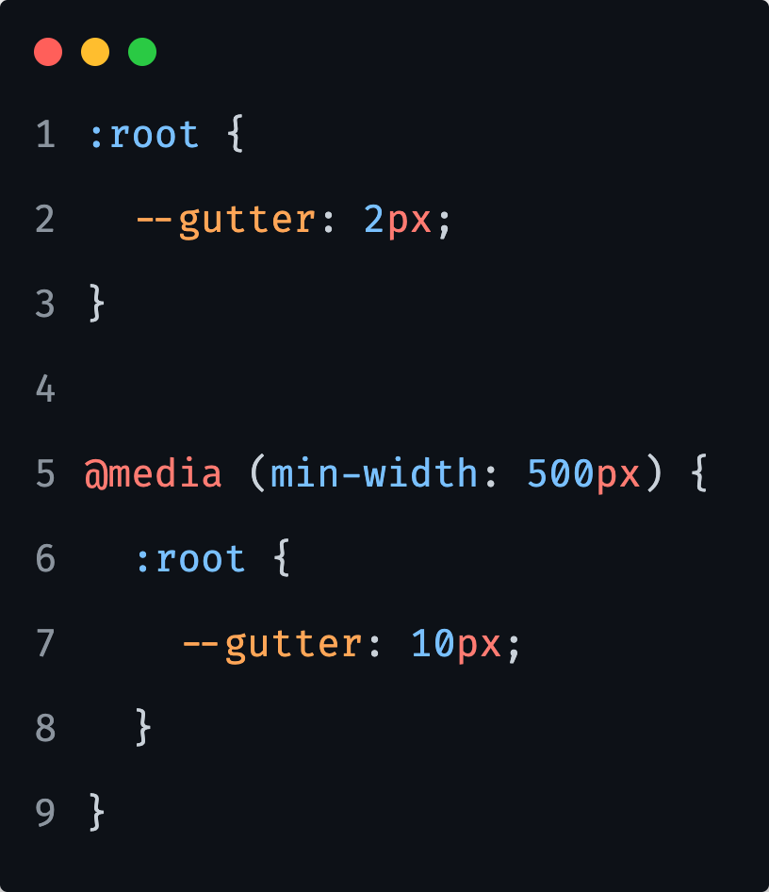
CSS Variables
CSS Variables make responsive design easier.
Notes:
We did not yet covered media queries, but we will in few days…
Explain in short what does the code above do really.
This can also be easily achieved with SASS variables as well.

Slide 59
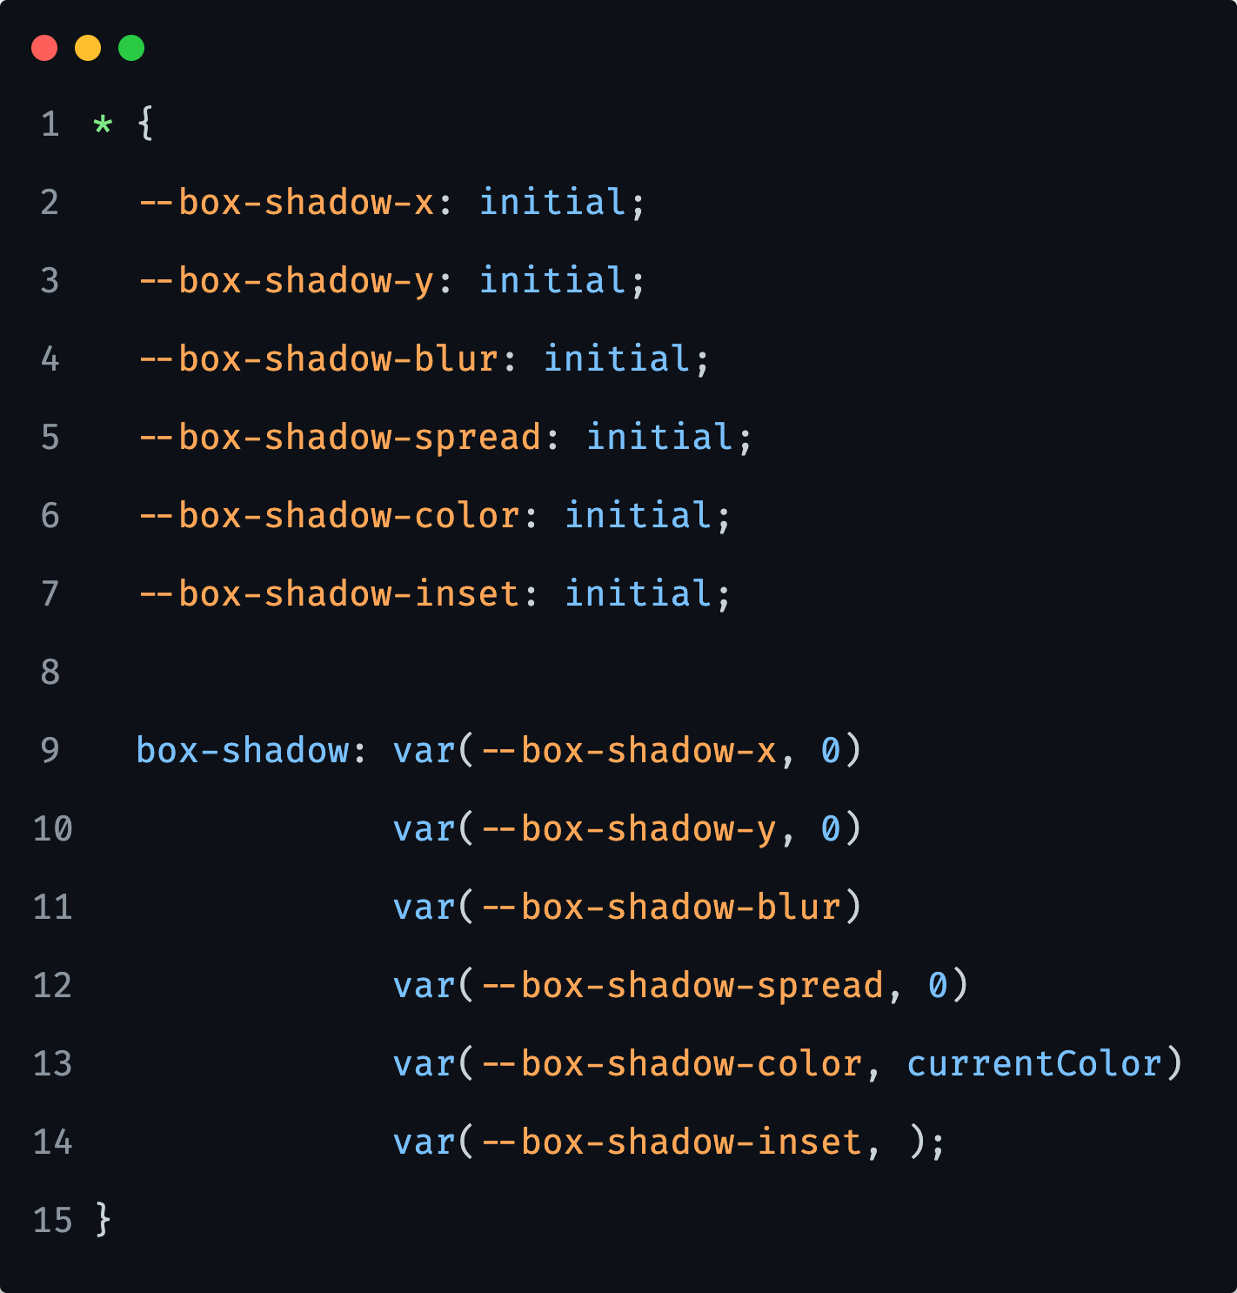
CSS Variables
CSS Variables allow us to create custom longhands.
Notes:
In this example, we can see how to create custom “property names” for a shorthand when defining a box shadow.
For this to work, we simply need to apply BLUR and we can also tweak any other variable locally then as well.

Slide 60
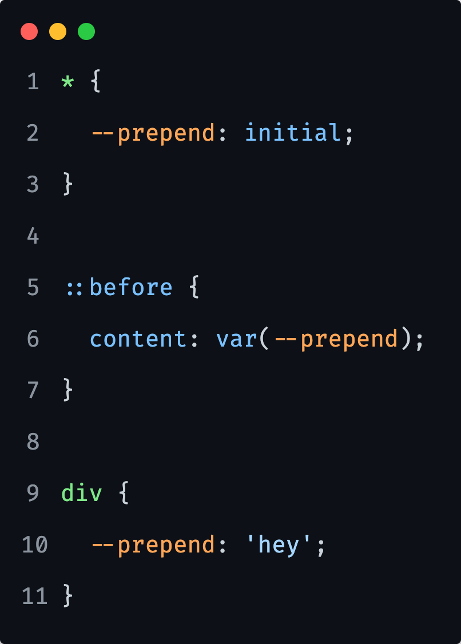
CSS Variables
CSS Variables allow us to create “our own” properties.
Notes:
This can be useful as well when it comes to JS manipulation, so applying some content before/after via inline styling.

Slide 61
Reference links

Slide 62

Reference links
Specificity
https://cssspecificity.com/
https://specificity.keegan.st/
Units
https://developer.mozilla.org/en-US/docs/Learn/CSS/Building_blocks/Values_and_units
https://www.w3schools.com/cssref/css_units.asp
Variables
https://developer.mozilla.org/en-US/docs/Web/CSS/Using_CSS_custom_properties

